Slide 1

Team 7 Iteration 2
Members: Paul Patraca Pantoja
Utsav Dhungana
Bipul Karki

Slide 2
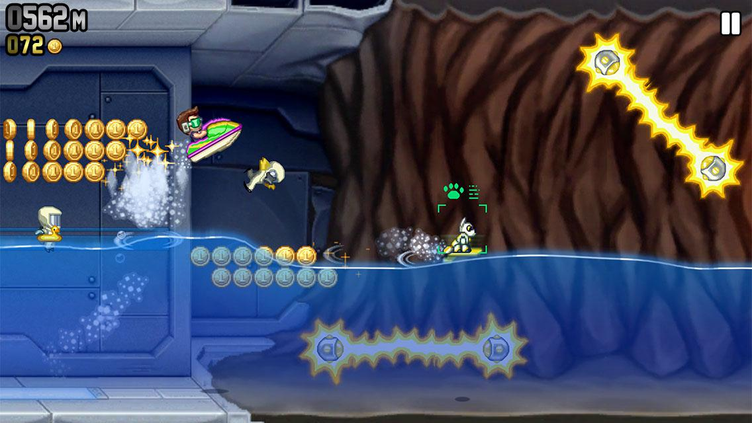
Closely Related apps:
Screenshot of jetpack joyride
https://halfbrick.com/our-games/jetpack-joyride/
No health-bar or any power ups
Tokens can be redeemed for gaining life
Not much to handle by AI
Non-Minimalistic

Slide 3
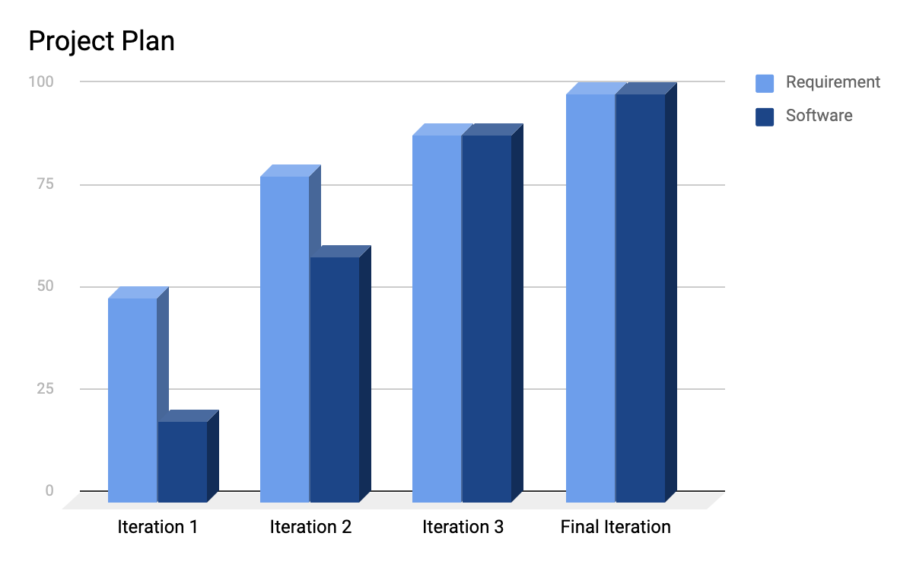
How is Carronade Doing?
Week one
M | T | W | TH | F | SA | SU
Virtual meeting and work on iteration documentation
Requirement Analysis and UML sketching
Start coding and Testing
Week Two
M | T | W | TH | F | SA | SU
Plan for next iteration; virtual meeting
Demo and requirement lookover
Finish up the final touches

Slide 4
Inputs and Outputs:
Input | Output
Keyboard Button ( S ) | Player moves down the screen
Keyboard Button ( A ) | Player moves towards left
Keyboard Button ( W ) | Player moves in upward direction
Keyboard Button ( D ) | Player moves towards right
Keyboard Button ( R ) | Resets the game
Keyboard Button ( Shift ) | Players go faster for the first or teleport for the second.

Slide 5
Top 5 Risks
No. | Risks | RE | Mitigate (How / When ?)
1 | Changes in the functional requirements. | RE = 0.4 * 20 = 8hrs | Changes in the gaming functionality is made during each iteration
2 | Unidentified risk; includes a member getting sick. | RE = 10 hrs | Healthy living environment and social distancing would mitigate the risk.
3 | Poor programming practices leading to memory leaks and slowing down the user’s machine; occurance of bugs. | RE= 4 hrs | Careful and thoughtful use of documentation and available resources can mitigate the probability of the risk during each iteration.
4 | Exceeding the deadline to complete the project i.e project not completed on time. | RE = 4 hrs | Making a good planning on project timeline for each iteration would solve the problem.
5 | Poor communication between the team members. | RE= 3 hrs | Strong communication throughout the class project using mediums like GroupMe.

Slide 6
Requirements
Req. ID | Requirements | Functional/Non-Functional | Implementation Planning | Updated/Added/Deleted
R2 | The System shall display health for the convenience of the Player | Functional | Iteration 2 | Updated / Implemented
R5 | The Player shall be able to choose from at least two different characters. | Functional | Iteration 2 | Updated / Implemented
R6 | The Player shall be able to choose from different characters. | Functional | Iteration 2 | Implemented
R9 | The Enemy director shall create at least three different types of enemies. | Functional | Iteration 2 | Implemented
R13 | The player shall be able to restart the game. | Functional | Iteration 2 | Implemented

Slide 7
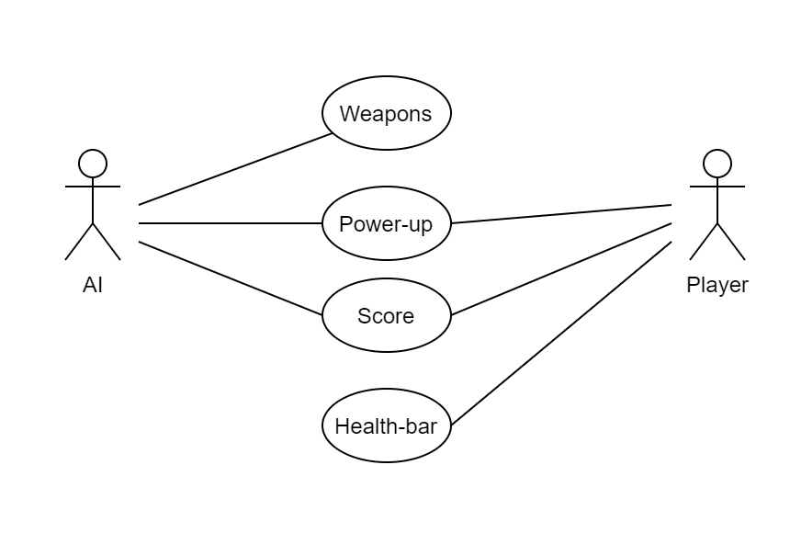
Use-Case

Slide 8
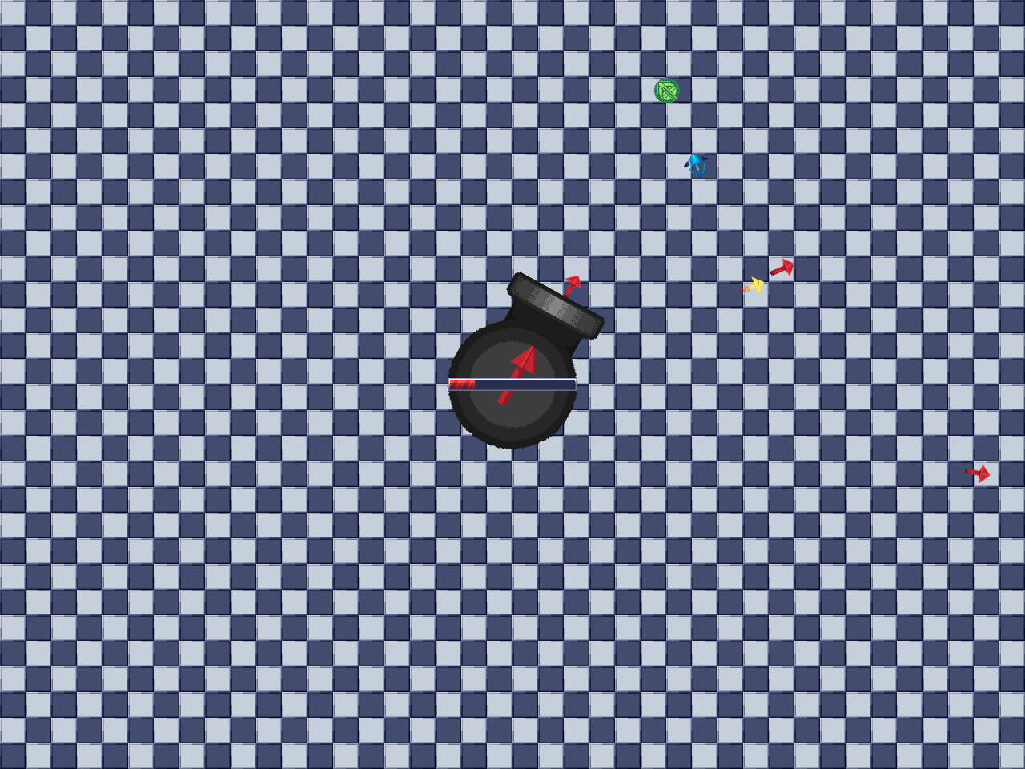
Sample prototype of the game
Play Screen 1.

Slide 9



Implemented Enemies
 | Straight Arrow - Flies forward, no gimmicks. 10 Damage
 | Accelerating Arrow - Starts slow and ramps up speed. 20 Damage
 | Turning Arrow - Turns towards the player relentlessly. 5 Damage

Slide 10


Implemented Power-Ups
 | Invincibility - Renders the player immune to all forms of damage
 | Recovery - Heals the player from 20 damage.

Slide 11


Implemented Player Types
 | Sprint - Average Speed, 50 max damage. Pressing SHIFT will greatly increase the movement speed for a brief moment
 | Blink - Higher Speed, 30 max damage. Pressing SHIFT will instantly teleport the player forward a bit

Slide 12
Users and Customers
GitHub Link :
https://github.com/udhungana/team7cse3311
Carronade Version 0.2
Generally, all the users who play this game are our customers.
Feedbacks from colleagues.
Provided online form to get feedback.
Friends with knowledge about virtual games.

Slide 13
References
https://commons.wikimedia.org/wiki/File:Carronade_12_pounder.jpg
https://github.com/udhungana/team7cse3311
https://mspoweruser.com/subway-surfers-updated-with-new-york-city-world-tour-in-windows-phone-store/
https://www.malavida.com/en/soft/jetpack-joyride/iphone/#gref

Slide 14
Questions?

